Slide 1
Infection Control In Clinical Setting

Slide 2
Definition of Infection
The invasion of body tissues by pathogenic microorganisms that proliferate, causing tissue injury and possibly disease.

Slide 3
Infection Prevention
Infection Prevention refers to policies and procedures to minimize spread of infections in healthcare settings.

Slide 4
Key Terms
Antiseptic: An agent that inhibits growth (but may not kill) microorganisms.
Asepsis: Being free from infection or preventing contact with microorganisms.
Autoclaving: Sterilization using steam under pressure.
Biohazardous waste: Items contaminated with blood, bodily fluids, secretions, or excretions.
Contamination: Becoming unclean or exposed to pathogens.
Cross-infection: Transmission of infection between individuals.
Decontamination: Removal of foreign material (e.g. blood) from objects.

Slide 5
Key Terms
Disinfection: Process to destroy pathogens (but not necessarily all organisms).
Infection: A disease state resulting from the invasion and growth of microbes in the body.
Infection Control: practices and procedures that prevent the spread of infection
Isolation: Separation of infected persons from non-infected persons which will prevent the transmission of infection to others
Medical asepsis: the state of being free of living pathogenic organisms
Microorganism: Bacteria, viruses, fungi, protozoa, etc.

Slide 6
Key Terms
Nasocomial infection (hospital-acquired infection): Infection favored by a hospital environment.
Pathogen: a microbe that is harmful and can cause an infection
Prophylactic: A measure (or medicine) used to prevent disease.
Purulent: containing, discharging or causing the production of pus
Reservoir: The habitat in which an infectious agent normally lives & multiplies.

Slide 7
Key Terms
Segregation: to separate or isolate from others or from a main body or group.
Sterile field: the area declared free from mico organisms or other infective agents.
Susceptibility: A condition of being vulnerable to infection , disease or disorder due to weakened defenses.
Sterilization: Destruction of all microorganisms, including spores. Medical asepsis: The state of being free of pathogenic microorganisms.
Surgical asepsis: Techniques to maintain items as sterile (free from all microbes).
Transmission: The means by which pathogens move from reservoir to host.

Slide 8
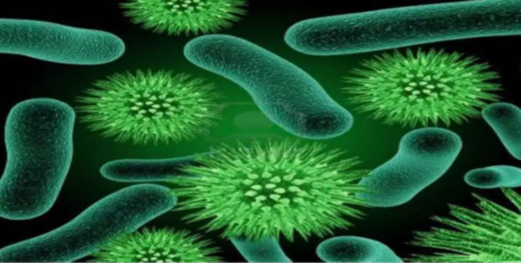
Bacteria

Slide 9
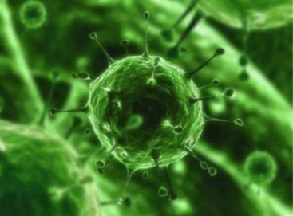
Virus

Slide 10
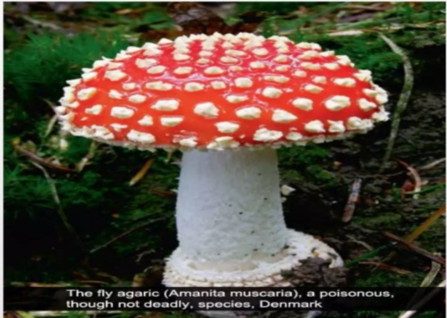
Fungi

Slide 11
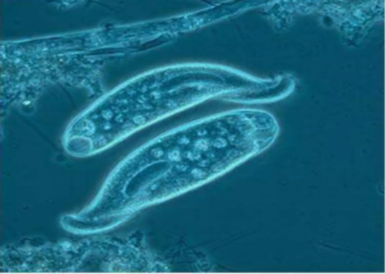
Protozoa

Slide 12
Nature of the Infection
Microorganisms exists everywhere: in water, soil, body surfaces such as skin, in body tracts (respiratory, GI, urinary) and other areas open to the outside (e.g mouth, upper respiratory tract, vagina and lower urinary tract) etc.
Many microorganisms are harmless or beneficial in that they perform essential functions in the body, produce substances called bacteriocins, which are lethal to related strains of bacteria.

